Slide 1
Natural Language Processing (NLP)
Lecture 13: Challenges in Predictive Analysis
Dr. Muhammad Taimoor Khan

Slide 2
Curse of Dimensionality
Too many features
Many features have little contribution towards prediction
The documents in the dataset are not enough (For a specialized problem)
To train a robust model we need few features and many samples (At what ratio! Depends on the nature of prediction model and application)
Domain specific codes, numbers, keys, alpha-numeric regos…

Slide 3

Dimensionality Reduction
But It’s a huge sparse matrix having most entries as zeros
Reduce the problem space
Considering multi-word features
Data cleansing
Stemming and Lemmatization
Parts of speech
…

Slide 4
Data Cleansing
Filter irrelevant / least known parts (Web-based data has a lot)
Filter or resolve (very common on social media)
unknown terms
spelling mistakes
shortened words
Over or under use of capitalization
Structures in Data
Ignore words in least concerned areas (e.g. web page footer)

Slide 5
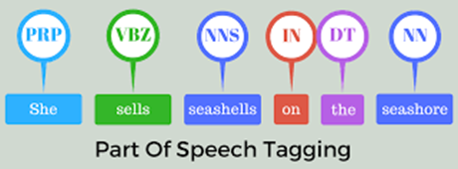
POS Tagging / Parsing
Also called grammatical tagging or word-category disambiguation
It’s the process of assigning parts-of-speech tags to words as per rules in language grammar

Slide 6
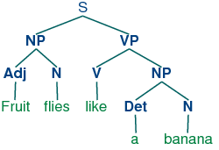
POS Parsing
Parsers generate a tree for each sentence using its parts of speech
It helps to identify the dependencies among terms
For examples answering questions like,
Who like banana
What does fruit flies like

Slide 7
Considering Multi-word Features
Using positional information
“World cup 2019”
Mutual information between words (sliding window)
battery, charger
Linguistic patterns (phrases)
All rights reserved, kicked off, pick up, turn around

Slide 8
Named entity recognition
United states of America, Nawaz Sharif, Geo News, Primer Minister
Semantics (From Dictionary)
Picture, Photo, still, click

Slide 9
Feature Selection
Applying feature selection to select only a subset of words that have high potential for prediction
Ranking feature attributes according to their predictive ability for the category under consideration
Retaining only top ranked features

Slide 10
Information Gain
Information Gain, IG (j ) = L_{label} – L(j)
It’s the expected information gain that is change in information entropy H from a prior state to a state that takes some information
Information Gain, IG(T, a) = H(T) – H(T | a)

Slide 11
Global vs Local Dictionary
Local dictionary for the desired label (class) only
Scenario:
For example, if we have 100 topics to categorize, then we have 100 binary prediction problems to solve. Our choices are 100 small dictionaries or one big one.

Slide 12
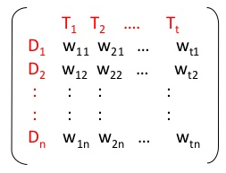
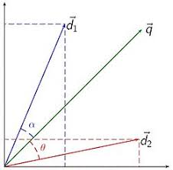
Prediction method
The similarity between two documents is based on the angle between its vectors (cosine similarity is usually used)
This representation is very helpful in document clustering and classification
Why angle? Why not the distance (Euclidean, manhattan or any other) between two documents

Slide 13

Stanford’s NLP Group (coreNLP)
Parts-of-Speech (POS) tagging
Named Entity Recognition (NER)
Co-reference resolution
Sentiment Analysis …
Stemming, Lemmatization, Tokenization …
Support multiple natural languages
Available for Java and Python

Slide 14
Imbalanced Class Representation
The real-world data may have disproportionate document representation for each type of label
The model is biased towards the label with higher representation
How to fix
Modify the modeling technique
Generate more representation (pseudo documents) for under represented label
…

Slide 15
Missing Values
A common issue in Machine Learning
Textual data does not face this problem
The VSM representation is for words that occur in a document
We never know, if there are any words missing in a document!

Slide 16
Overfitting vs Underfitting
Actually, we should probably penalize the more complex models, even if they are more accurate, since more complex models are more likely to overfit
Accuracy = 94%
Accuracy = 100%
Accuracy = 100%
10
10
10
9
9
9
8
8
8
7
7
7
6
6
6
5
5
5
4
4
4
3
3
3
2
2
2
1
1
1
1
2
3
4
5
6
7
8
9
10
1
2
3
4
5
6
7
8
9
10
1
2
3
4
5
6
7
8
9
10

Slide 17
Large-scale Data (Big Data)
For data mining with massive datasets, it is not so much the (main memory) time complexity that matters, rather it is how many times we have to scan the database
This is because for most data mining operations, disk access times completely dominate the CPU times.
Its often reported as the number of times you scan the database

Slide 18
Streaming Data
The data may be acquired from an online source
Can the model trained on old data keep up with the newly evolving documents

